Slide 1
_____OFFSYNC_____
Office Management System
Guide : Dr. Smitha Vinod
Aashi N Chopda 2141043
Arpita Dash 2141047
Dechamma P T 2141048

Slide 2
Introduction
In today's fast-paced business environment, effective office management is crucial for smooth operations and increased productivity. An online office management system is a comprehensive solution that streamlines various administrative tasks and optimizes resource utilization. This system offers efficient tools and features to facilitate rental and scheduling of cabs for office employees and renting out office equipment. Let's explore the key components and benefits of such a system:
● Cab rental management
● Equipment Rental Management
Moreover, an online office management system provides a centralized platform for managing various administrative tasks, including cab rentals and equipment reservations. By automating and streamlining these processes, the system enhances efficiency, reduces manual effort, and improves overall productivity. It offers benefits like cost control, resource optimization, and data-driven decision-making. Implementing such a system can significantly contribute to a well-organized and smoothly functioning office environment

Slide 3
Existing Systems
MoveInSync, TaxiWala taxis, Ola Corporate, Careem for business, rentomojo, furlenco and scoop( are a few examples of systems for cab and rental services that already exist. These service providers are all good at what they do, so we will only improve on what they now offer. We promise a hassle-free booking experience, secure transportation, and protection for women by employing a significant number of female drivers for our cabs.
Through our equipment portal, we will also provide our users the ability to rent out all the tools they need for special office conferences and meetings. If a problem arises, we will dispatch service personnel effective immediately.
OFFSYNC website strives to offer businesses an all-in-one platform where they can come and enjoy a hassle-free experience when renting out equipment and booking cabs at the same time.It will make work for businesses a lot simpler for all of the last-minute conferences and meetings they are scrambling to schedule. It also strives to achieve following sustainable development goals such as no poverty, no hunger, gender equality and industry innovation and infrastructure.

Slide 4
Proposed System
The system will be having three roles- Admin, Service Providers and Employees/staffs.
● Admin: The admin manages the data within the system, ensuring its accuracy, security, and integrity. The admin is responsible for managing user accounts within the system. This involves creating and maintaining user profiles, granting appropriate access levels and permissions, and managing user roles and responsibilities.
● Service Providers: External cab rental companies and equipment rental vendors are essential users, as they provide the services and resources needed by the organization.
● Employees/Staff: These are the individuals who work in the office and require the use of cabs and office equipment. They use the system to schedule cab pickups, book rentals, and manage their office equipment needs.

Slide 5
MODULES
Cab Rental Management: This module is responsible for managing the rental of cabs for office employees. It allows companies to book cabs for their employees, and assign drivers to cabs. The module also generates reports on cab utilization and expenses. This module is important for businesses with a large number of employees who need to travel frequently. It can help to save time and money by streamlining the cab booking process and ensuring that cabs are used efficiently.
Equipment Rental Management: This module is responsible for managing the rental of office equipment. It allows employees to reserve equipment, track its availability, schedule maintenance or repairs, and generate invoices. The module also manages the equipment inventory and generates rental reports. This module is important for businesses that need to rent out office equipment to employees or customers. It can help to ensure that equipment is used efficiently and that rental payments are collected on time.

Slide 6
Financial Management: This module is responsible for handling financial processes such as invoicing and financial reporting. It allows users to track and manage expenses, generate invoices and receipts, and generate financial reports for analysis. This module is important for businesses of all sizes. It can help to improve financial decision-making by providing insights into the company's financial performance.
Information Management: This module deals with the storage, organization, and retrieval of office information in a digital format.

Slide 7
DESIGN

Slide 8
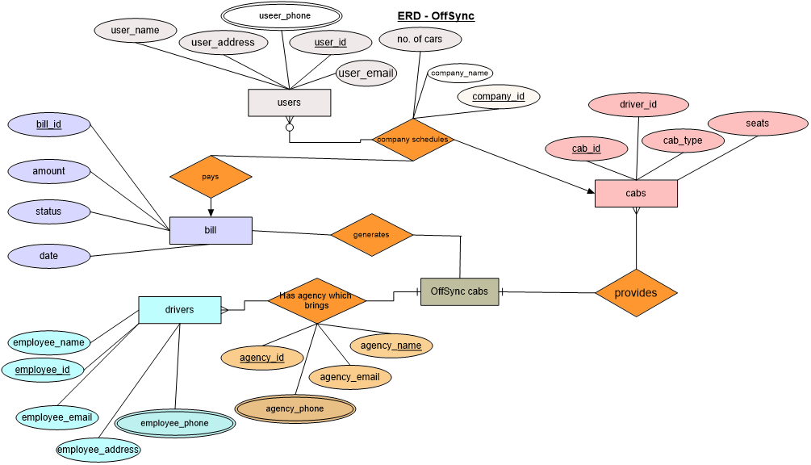
ER DIAGRAM - CAB RENTAL

Slide 9
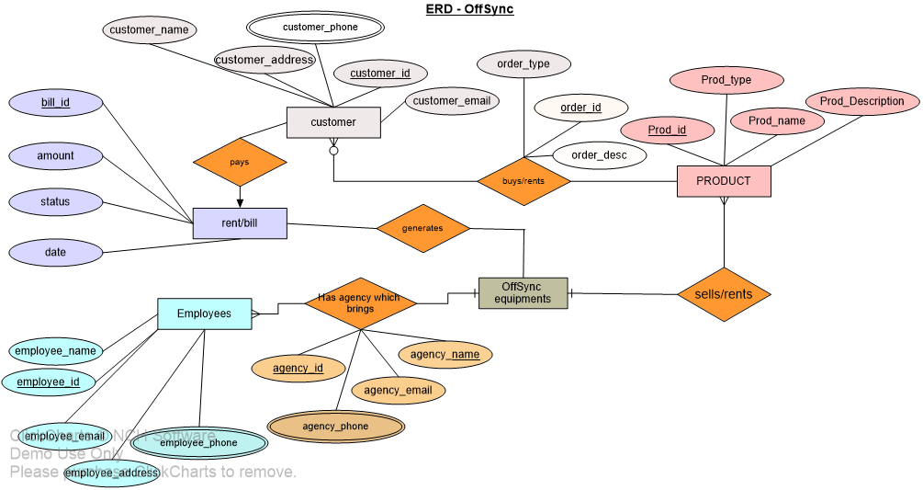
ER Diagram - EQUIPMENT RENTAL

Slide 10
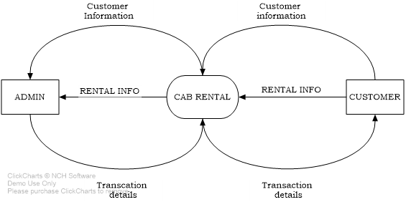
Data Flow diagram level 0 - CAB RENTAL

Slide 11
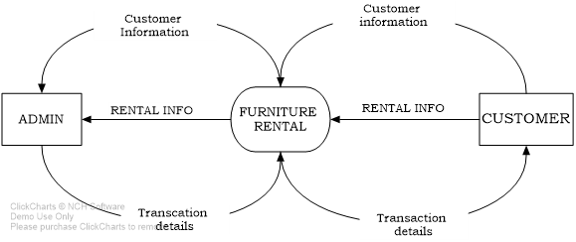
Data Flow diagram level 0 - EQUIPMENT RENTAL

Slide 12
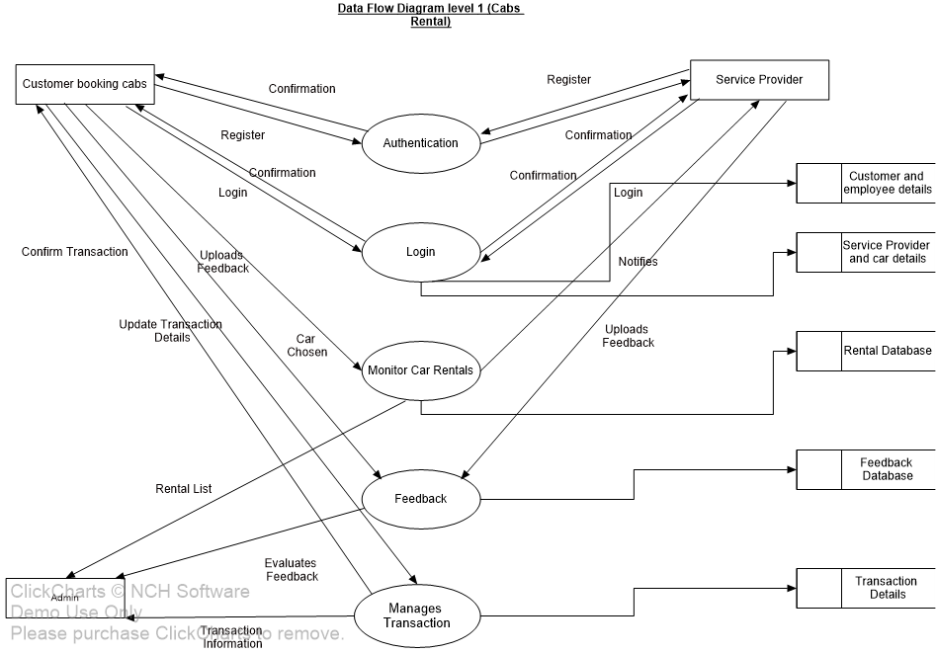
Data Flow Diagram level 1
CAB RENTAL

Slide 13
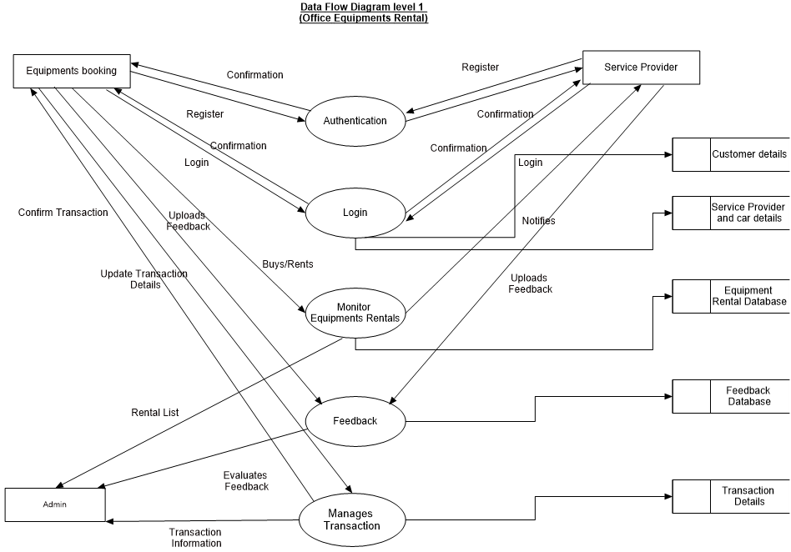
Data Flow Diagram level 1
EQUIPMENT RENTAL

Slide 14
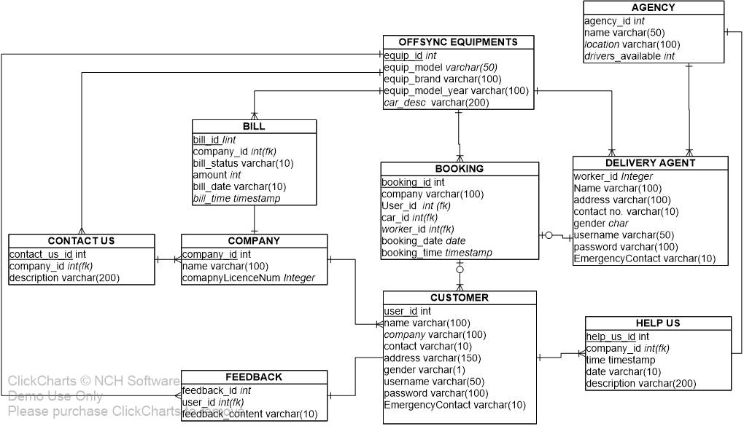
OFFSYNC EQUIPMENTS RENTAL SCHEMA

Slide 15
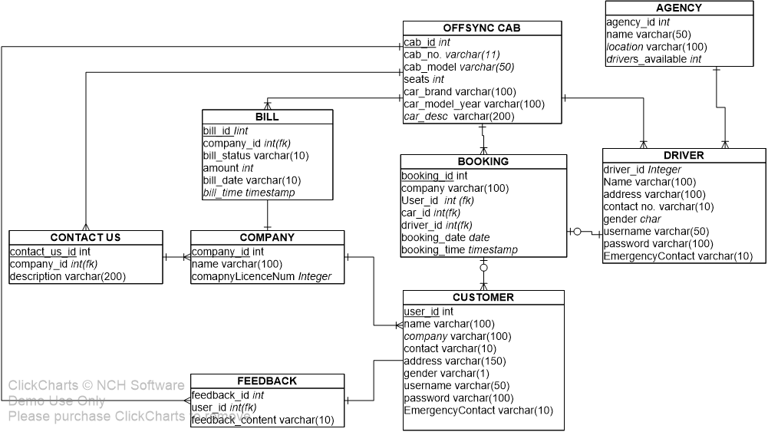
OFFSYNC CAB RENTAL SCHEMA

Slide 16
Admin
The admin module is for the administrator or the manager who has access to change the informations of cabs , equipments, time slots etc. after authentication.
This module contains the information of admin like username and functions for authentication, changing company details and prices.

Slide 17
End User
The User Module consists of class user which contains the user’s information, email-id, username etc.
It has functions to authenticate the user.
After authentication, the user can make transactions for bookings.

Slide 18
FUNCTIONAL REQUIREMENTS

Slide 19
User Registration and Authentication:
● Users will be able to register and create accounts with different roles (Admin, Service Providers, Employees/Staff).
● The system will authenticate users and grant appropriate access based on their roles.
Cab Rental Management:
● Companies will be able to request cab bookings with details such as date, time, and pickup location.
● The system will check cab availability for the requested date and time.
● Generate cab utilization reports, including data on cab usage frequency and duration.
● Track and manage cab rental expenses for financial reporting.

Slide 20
Equipment Rental Management:
● Employees will be able to reserve office equipment with specified rental durations.
● The system will maintain an updated inventory of available equipment.
● Schedule maintenance or repairs for equipment as needed.
● Generate invoices for equipment rentals and track payment status.
● Maintain a record of equipment returns and updates to the inventory.
Information Management:
● Admin will have the ability to add, edit, and delete office-related information such as employee records, rental records, and service provider details.
● Ensure data integrity and security by allowing access to authorized users only.
● Retrieve office information efficiently based on user queries.

Slide 21
Financial Management:
● The system will generate invoices and receipts for cab and equipment rentals.
● Provide an option for users to view and track their financial transactions.
● Generate financial reports, including expense reports and revenue generated through rentals.
● Allow Admin to manage and track financial data securely.
Notifications and Reminders:
● The system will send notifications and reminders to employees, cab drivers, and rental companies regarding booking details, scheduled rides, maintenance updates, etc.

Slide 22
Feedback and Rating System:
● The system will be implementing a feedback and rating system where employees can provide reviews and ratings for cab rides and rented equipment.
Donation Option for Sustainable Development Goals:
● The system will be including a one rupee donation option for users to contribute to providing food for those in need, aligning with the goal of "No Hunger.“
Integration with External Agencies:
● The system will be integrating with external agencies for drivers, delivery agents and technicians.

Slide 23
NON-FUNCTIONAL REQUIREMENTS

Slide 24
Reporting and Analytics:
● The system will be providing comprehensive reporting and analytics features for different user roles to make data-driven decisions.
● It will be generating reports on cab and equipment utilization, financial performance, and donation contributions.
Accessibility and Usability:
● It will be ensuring that the system is user-friendly and accessible to users with different levels of technical expertise.
● It will be implement responsive design for seamless access on various devices.
Security and Privacy:
● It will be implementing robust security measures to protect user data and prevent unauthorized access.
● It will be complying with data protection regulations and ensure user privacy.

Slide 25
Tools Proposed
HTML (Hypertext Markup Language): HTML forms the foundation of web content. It structures the elements on a webpage, from headings and paragraphs to images and links, providing the essential structure and layout.
CSS (Cascading Style Sheets): CSS is responsible for the presentation and design of a website. It allows developers to control the visual aspects, such as colors, fonts, spacing, and responsive layouts, ensuring a consistent and visually appealing user experience.
JavaScript: JavaScript is the key to interactivity. It adds dynamic behavior to web pages, enabling features like animations, form validation, real-time updates, and more. With the ability to interact with both HTML and CSS, JavaScript makes web applications engaging and responsive.
PHP (Hypertext Preprocessor): PHP is a server-side scripting language that empowers developers to build dynamic web pages and applications. It can seamlessly integrate with databases, generate dynamic content, and handle complex backend tasks, making it an essential tool for creating interactive and data-driven websites.

Slide 26
MySQL: MySQL is a robust relational database management system. It complements PHP by providing a structured environment to store, manage, and retrieve data efficiently. It's indispensable for applications that require data storage, retrieval, and manipulation, such as e-commerce platforms, content management systems, and more.
Bootstrap: Bootstrap is a popular front-end framework that simplifies and expedites the process of designing and developing responsive and visually appealing websites.

Slide 27
UI DESIGN

Slide 28
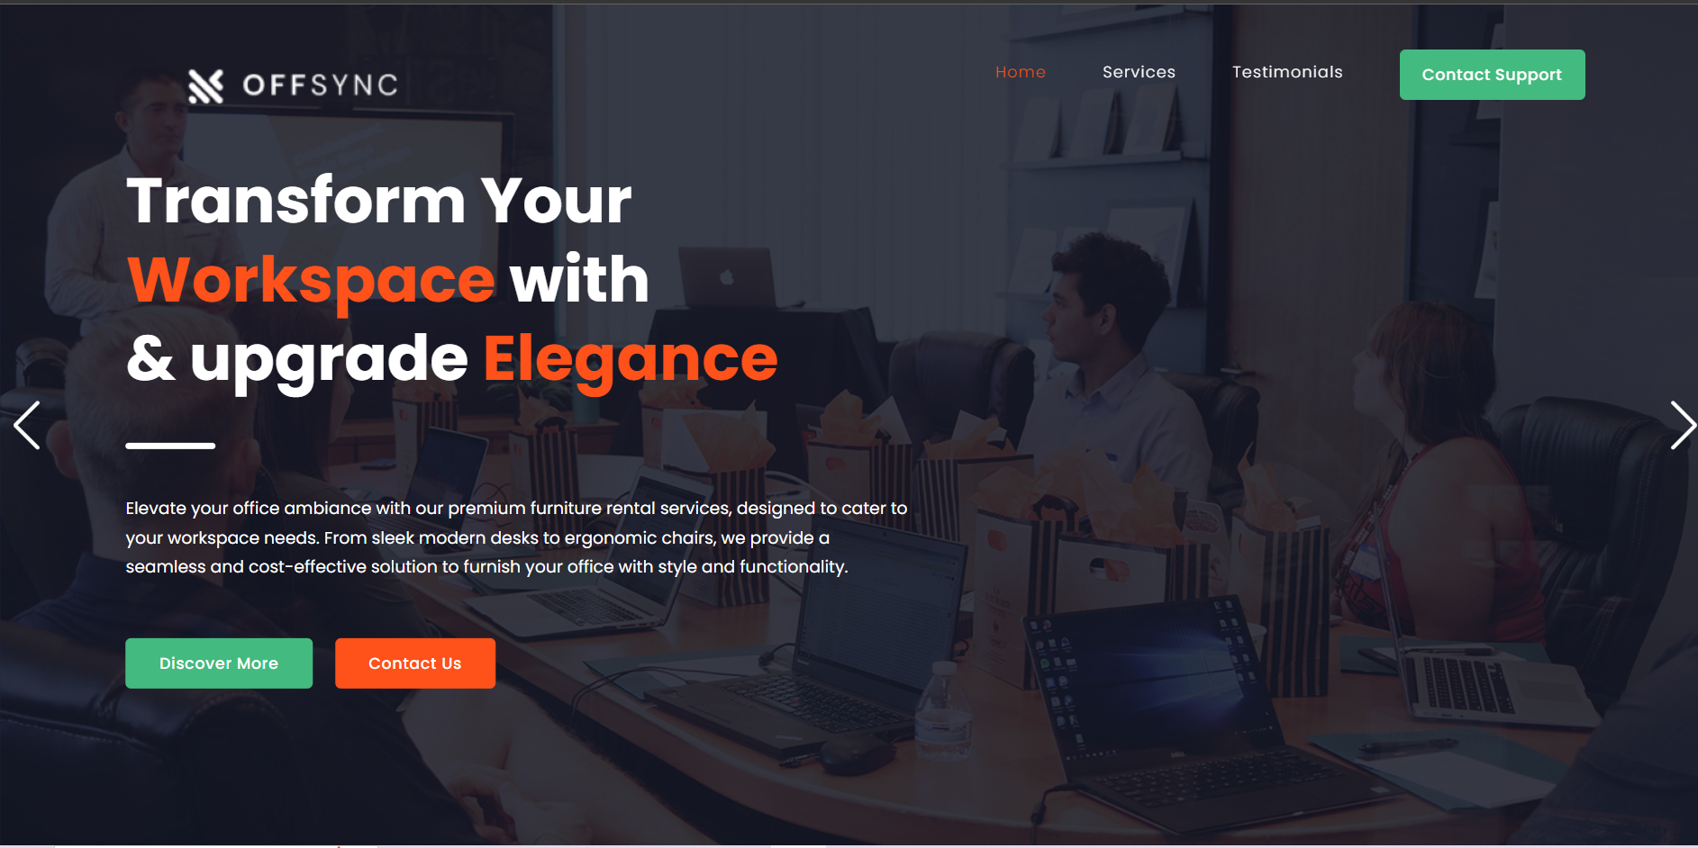

Slide 29
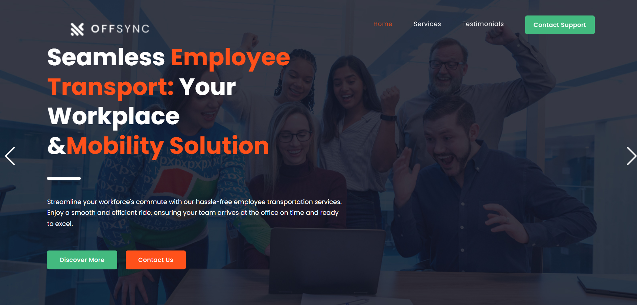

Slide 30
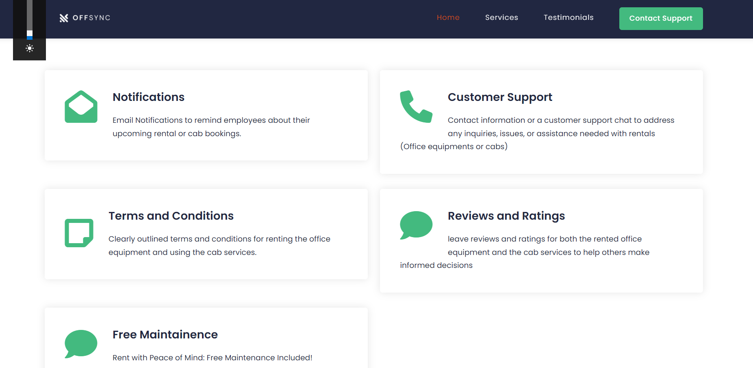
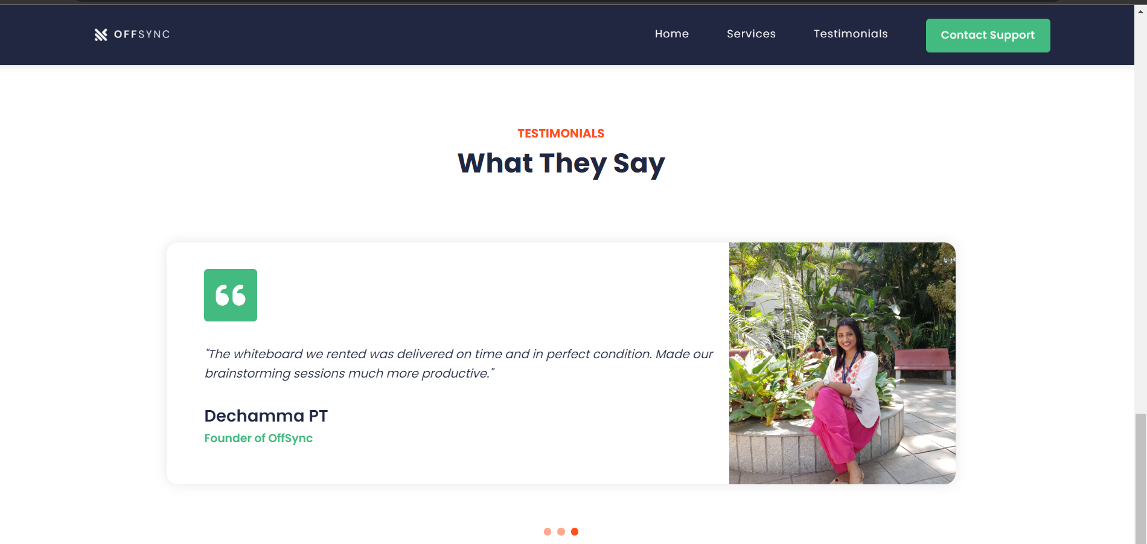

Slide 31
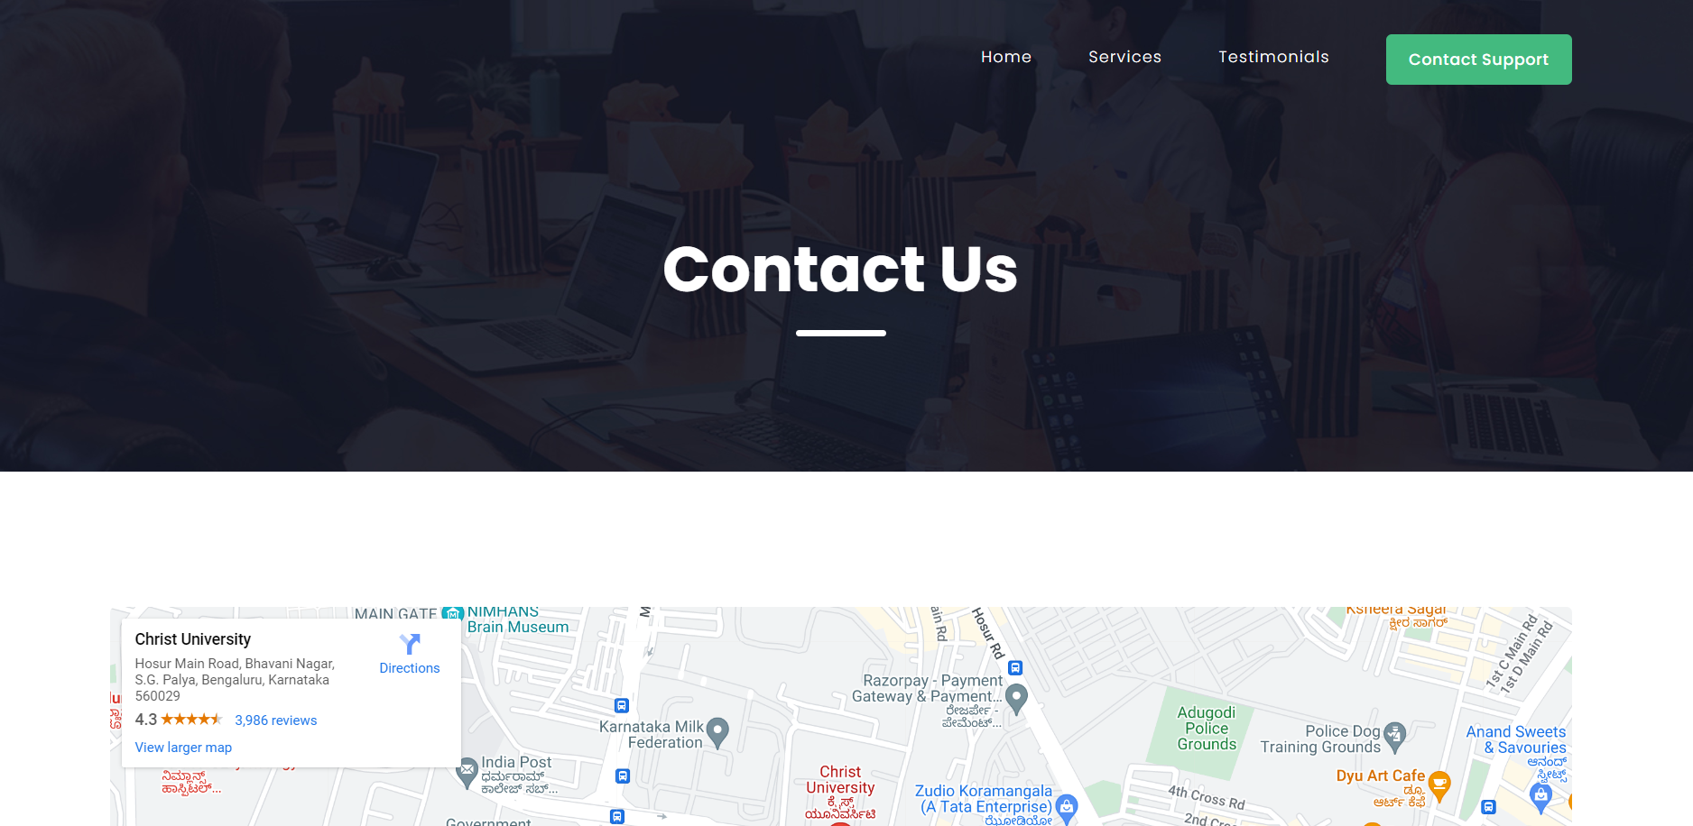
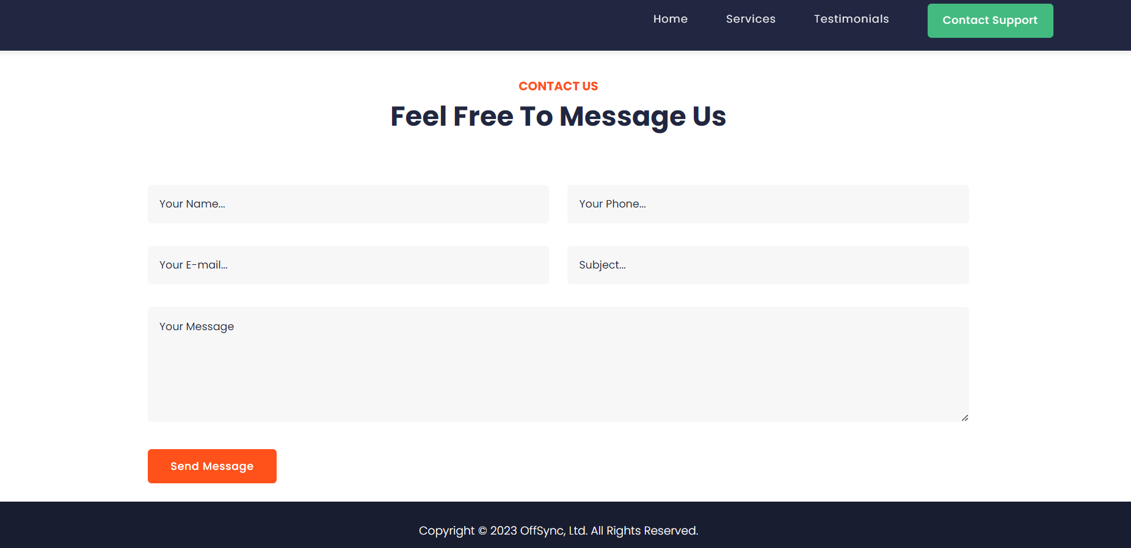

Slide 32
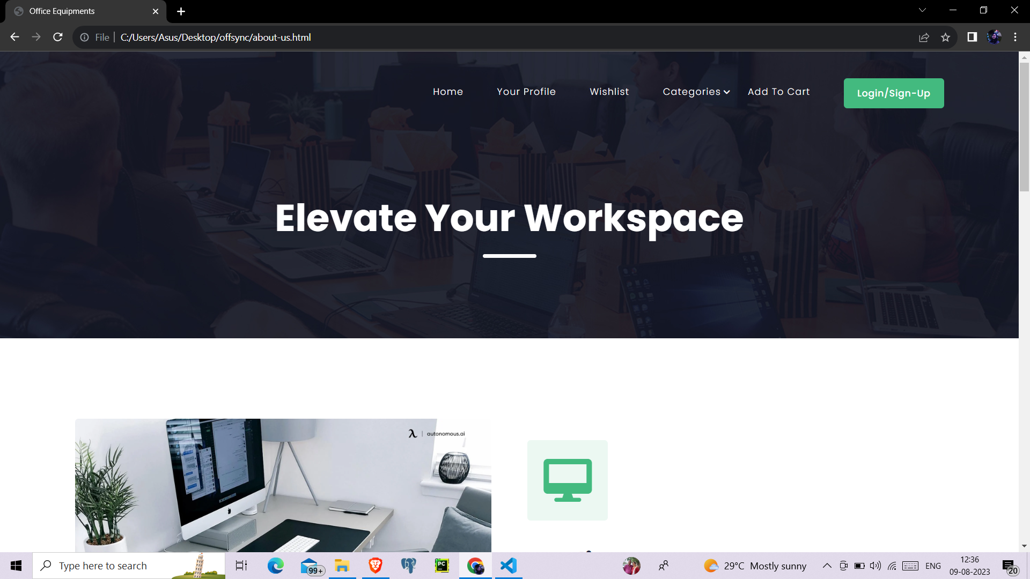
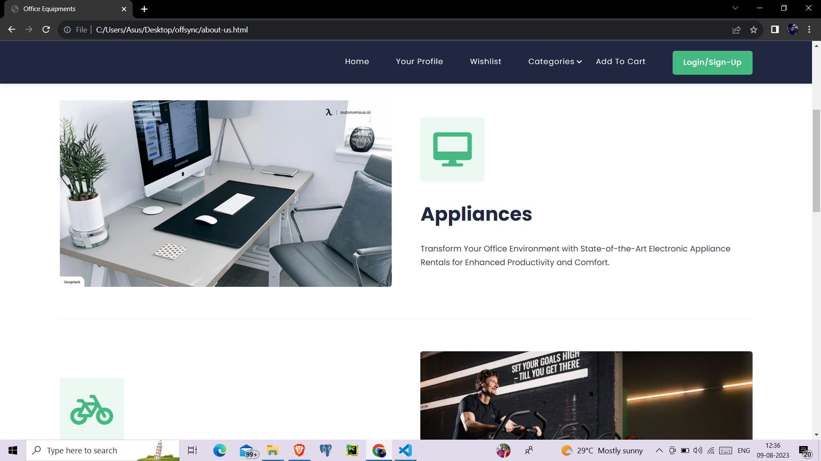

Slide 33
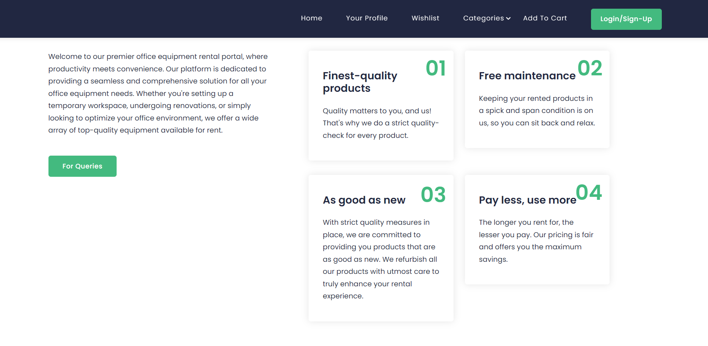

Slide 34
THANK YOU

